Slide 1
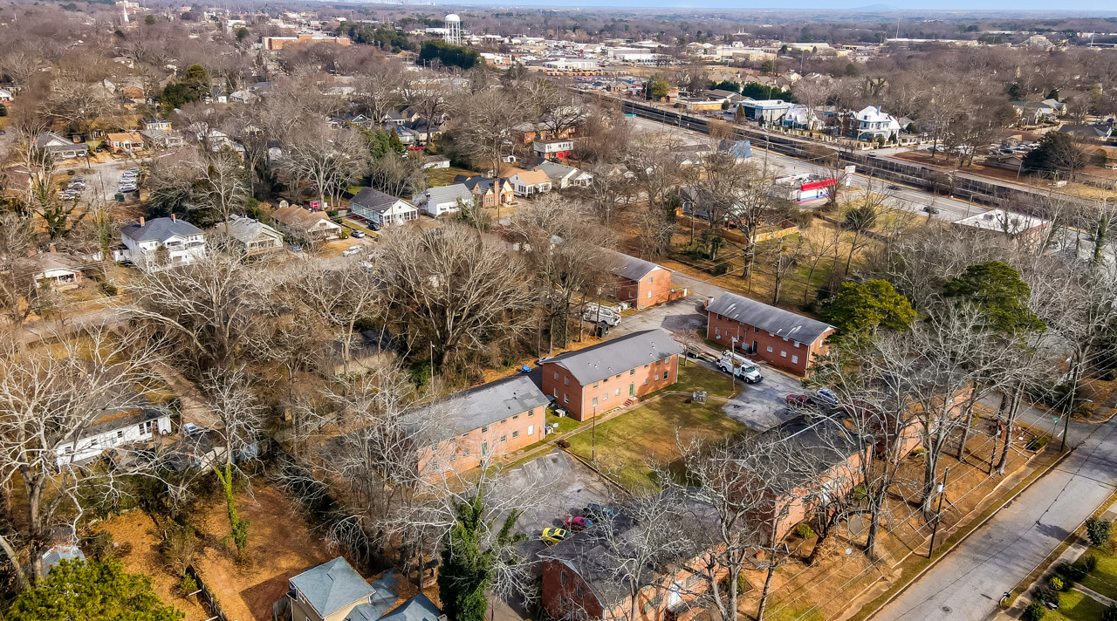
WOODWARD ESTATE APARTENTS
28unit 7- property Value-Add Multifamily
Investment Opportunity
College Park, Georgia

Slide 2
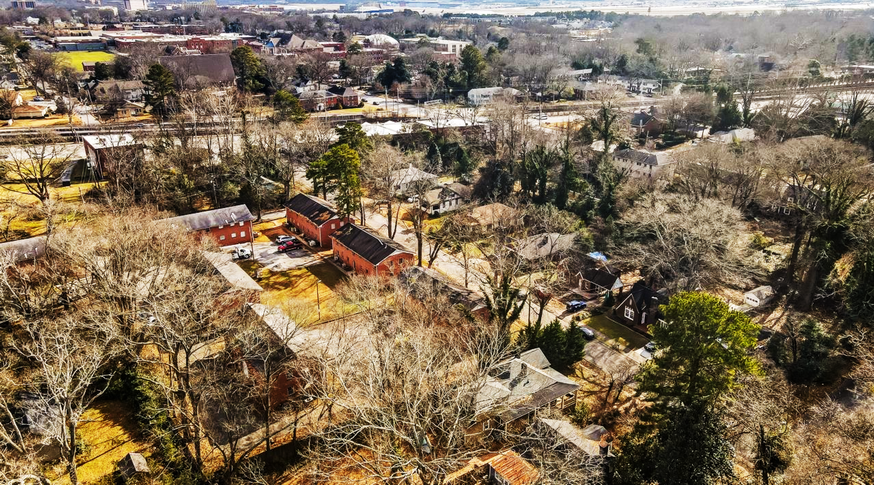
CONFIDENTIAL
INVESTMENT SUMMARY
This presentation is for informational purposes only and is not an offering or solicitation of an offer. Any such offer or solicitation will only be made to qualified investors by means of confidential communication bound by non-disclosure and non circumvent agreements and only in those jurisdictions where permitted by law. An investment should only be made after thorough review of the information provided and after due diligence.
An investment is speculative and involves a high degree of risk. Opportunities for withdrawal, redemption and transferability of interests are limited, so investors may not have access to capital when it is needed. No assurance can be given that the investment objective will be achieved or that an investor will receive a return of all or any portion of his or her investment. Investment results may vary substantially over any given time period. Certain data contained herein is based on information obtained from sources believed to be accurate, but we cannot guarantee the accuracy of such information.

Slide 3
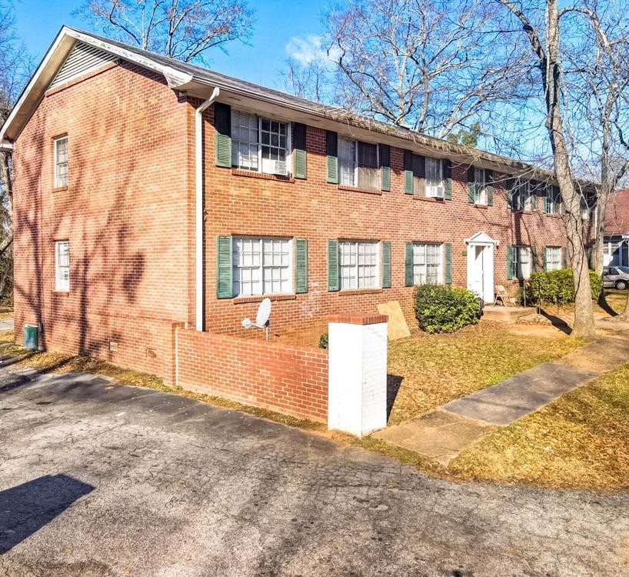
TABLE OF CONTENTS
01
Executive Summary
02
Project Overview
03
Management Team
04
Market Overview
05
Financial Analysis
06
Appendix
07
Contact US
Notes:
© Copyright Showeet.com

Slide 4
EXECUTIVE SUMMARY
WOODWARD ESTATE APARTMENTS
VALUE ADD
OPPORTUNITY
MANAGEMENT
TIMELINE AND RETURNS
28unit Class- C Value-Add 7 Separate Complexes of 4 units each in the city of College Park.
All Properties are in Class C Neighborhoods Surrounded by Single-Family Residences.
Less than 2 miles from Hartsfield- Jackson Atlanta International Airport.
Current Physical Occupancy under 50%.
Attractive Purchase Price at 2.1m at $75,000.00 per unit.
Huge Opportunity with $208K Investment for Forced Appreciation to increase value to $2.08m.
26 Units needing cosmetic rehab.
New Professional Management will be placed On Site during Contract Phase for smooth transition.
Licensed contractors with experience for future renovations.
Experienced team with an extensive track record.
New On-Stie Leasing and
Maintenance Managers
18-24 Month Renovation Scheduled to Update 26 Remaining Unrenovated Units
Return 50% of Cash at Refinance in 24-36 Months.
75/25 JV Split Between Capital and Operational Partners, with 8% preferred given quarterly starting month 12.

Slide 5
PROJECT
OVERVIEW

Slide 6
INVESTMENT AT A GLANCE
INVESTMENT SUMMARY
INVESTOR RETURNS
 | Purchase Price | $2,100,000
 | Capital Improvement Budget | $208,000
 | Total Equity Required (Down Payment, Closing, Fees, Renovations) | 973,812
 | Equity Returned at Refinance (expected in 24-36 months) | 50%
 | Estimated Hold Period (Depending on Market Conditions) | 7 Years
 | Annual Cash-on-Cash Return (Overall Cash-on-Cash) | 12.89% 15.37%
 | Investor Equity Multiple | 3.24x
 | Total ROI (after Capital Return) | 136.5%
 | Internal Rate of Return (IRR) (Includes proceeds from sale) | 20.95%
 | Partnership Split Operations / Capital | 75/25

Slide 7
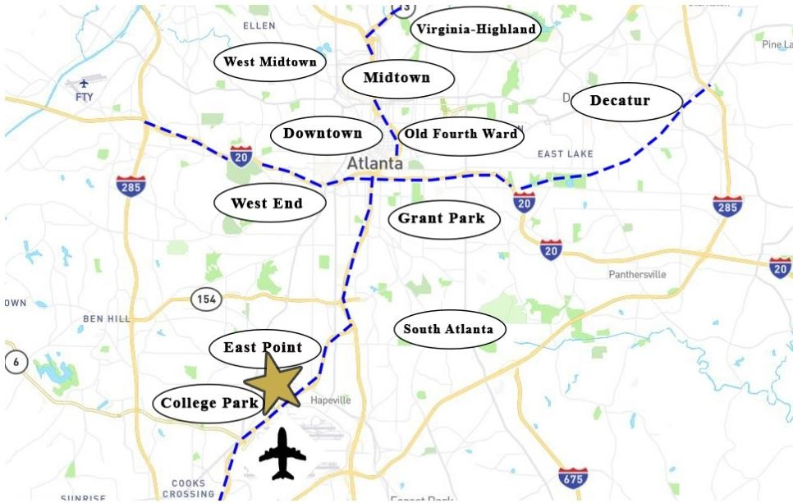
LOCATION PROXIMITY: A T L A N T A M A P

Slide 8
ATLANTA
BUSINES S- FRIEND LY CITY
Atlanta, the capital and most populous city in Georgia, is the ninth-largest metro in the United States with over 5.9 million residents. It prides itself on its low business costs, tax-friendly environment, diverse economy and suburb quality of life. Encompassing a GDP over $270 billion, the Atlanta metropolitan area is a true “world city.”
HOME TO FO RT UNE 500 COMPANI ES
Atlanta has the third-highest concentration of Fortune 500 headquarters in the U.S., and over 75% of the Fortune 1000 conduct business in the Atlanta Metropolitan Area. The city is the global headquarters of corporations such as The Coca-Cola Company, The Home Depot, Delta Air Lines, AT&T Mobility, UPS and Newell-Rubbermaid.
CONTINUOUS ECONOMIC DEVE LO PMENT
The city’s continuous growth is expected to continue with recently executed or announced corporate relocations such as UPS, Mercedes-Benz, NCR, Honeywell, and General Electric. Atlanta has also become a mega center for movie production due to tax credits implemented in 2008.
WORLD- CLASS EDUC ATION
Atlanta houses several of the top higher education institutions in the United States including Georgia Institute of Technology, Emory University, Georgia State University and Kennesaw State University.
AT TRACTIONS AND TOURISM
Attractions in Atlanta include the largest aquarium in the western hemisphere, the CNN Center, the Fox Theater, the King Center and the new $1.5 billion home of the Atlanta Falcons football franchise, Mercedes-Benz Stadium. Hartsfield-Jackson Atlanta International Airport is the world’s busiest airport, making the city a hub for business and tourism travelers alike.
#1 Most-Traveled Airport
in the World
$270 Billion GDP in
Metro-Atlanta
17 Fortune
500 HQ in Atlanta
Top U.S. Metro with #1 Lowest Cost of Doing Business
Georgia Tech’s Technology Square is a R&D incubator for over 100 companies and is “one of the incubators changing the world.” -Forbes 2010 & 2013
#4 Metro Area for Largest Increase in Population, 2015-2016 -U.S. Census
Bureau Population Division

Slide 9
BUSINESS PLAN
28 UNITS
26 UNITS TO RENOVATE
BRING OCCUPANCY FROM 50% TO 95%
IMPROVE LANDSCAPING
IMPROVE MANAGEMENT PRODUCTIVITY
IMPROVE CURB APPEAL

Slide 10
ADD OVERVIEW
We plan to reposition this property through increased gross revenue through renovations, added premium rents, landscaping, curb appeal, and other improvements to increase the value for refinance and sell of the property.
Commercial properties are valued by the income they produce, for every dollar spent to increase annual income this yields a return on that investment by increasing the value upon sale.
Current Property Gross Income: $215,615.15 Pro Forma Gross Income by Year 3: $345,600
Income Spread: $129,984.85
= $2,079,757.60 Increased Value
Anticipated Cap Rate: 6.25%
ESTIMATED COST: $239,200 = ROI 870%

Slide 11
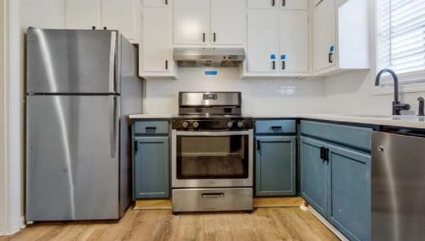
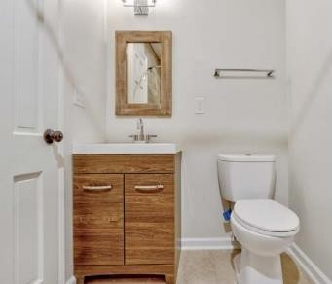
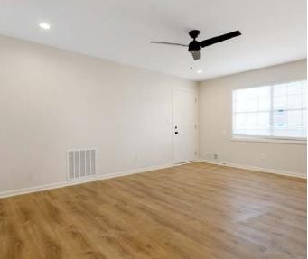
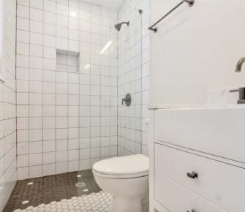
RENOVATIONS
RECENT REN OVATIONS
2 of the 28 units have been recently renovated. The units are spacious and offer an open floor plan with the 2 bedroom being 850 SF and the 3 bedroom being 1,050 SF. These improvements allowed for an increase in rents from $628 to
$1,200.
Quartz countertops
Tiled backsplash
Stainless steel appliance package that includes
Dishwasher
Walk-in shower
New flooring
Recessed lighting
New HVAC

Slide 12
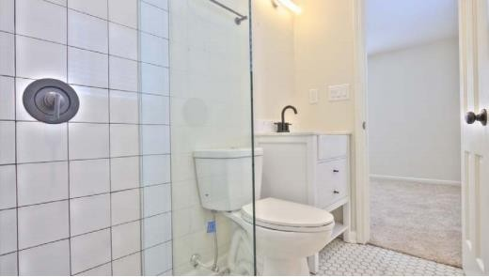
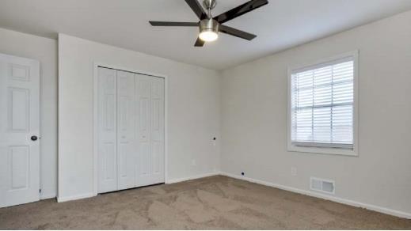
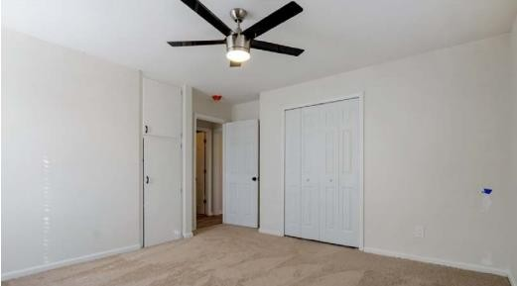
RENOVATED UNITS

Slide 13
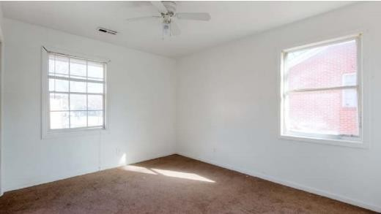
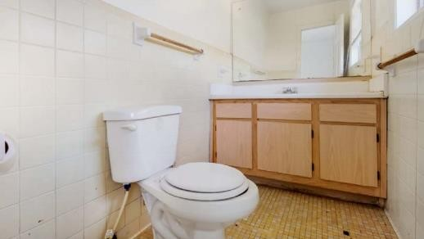
STANDARD UNITS

Slide 14
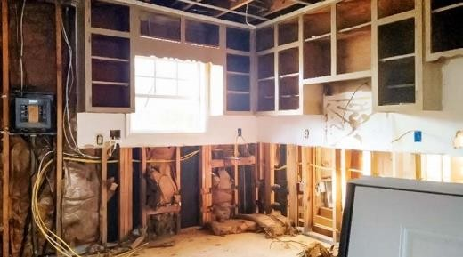
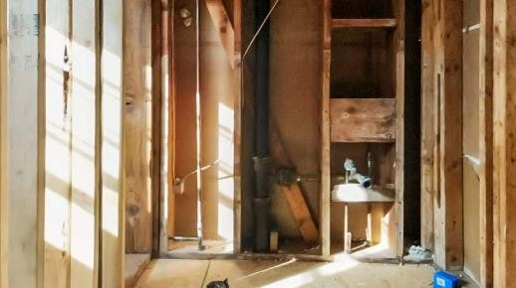
UNFINISHED UNITS

Slide 15
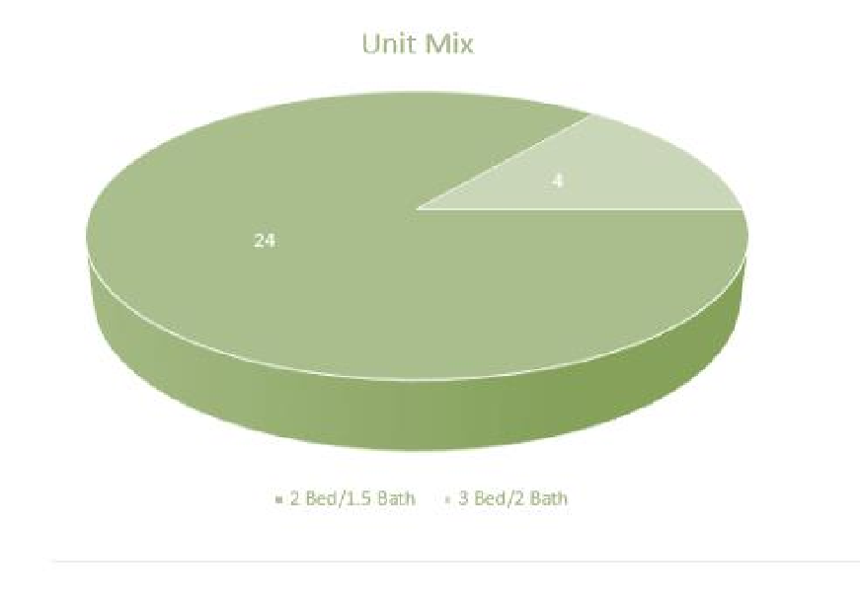
UNIT MIX
UNIT TYPE | UNIT COUNT | % TOTAL | UNIT SIZE | PROJECTED RENT | RENT/SF
2 BR / 1.5 BA | 24 | 86% | 850 SF | $1,000 | $1.33
3 BR / 2 BA | 4 | 14% | 1050 SF | $1,200 | $1.44
TOTALS/AVERAGES | 28 | 100% | 24,600 SF | $28,800 | $1.37
Market Gross Annual Rent: $345,600

Slide 16
TIMELINE
Analysis Begin Date January, 2022
13 units of 26 Rehab complete With 10 of the 13 units occupied
JAN
FEB
MAR
APR
MAY
JUN
JUL
AUG
SEP
OCT
NOV
DEC
JAN
FEB
MAR
APR
MAY
JUN
JUL
AUG
SEP
OCT
NOV
DEC
2022
Rebrand Management replacement Begin Rehab
2023
100% Rehab
95% Occupancy
Begin Refinance

Slide 17
U.R.P. PROPERTIES
U.R.P. Properties finds and manages repositioning opportunities in researched markets within the southeast regions. Mainly focused on creating opportunistic valued investments for passive and active investors through partnerships. Along side U.R.P. our investors will be apart of a team whose expertise is in operational management, with its founders being prior and active military member, as well as an advisory team with over 100 years of real estate experienced combined, and over $3Billion in RE transactions.
John Coppock has been passionate and around real estate since the age of 7. He comes with over a decade of operational management experience gained from his military service.
John’s attention to detail gives him the ability to understand, analyze, and reposition potential deals along with his team. John enjoys creating value through real estate, and meeting people. His background in managing over $15M worth of military grade equipment and personnel, ensures efficiency and productivity for a business plan, which he calls “the mission” to be executed to the highest standard possible.
Living in Columbus/Fort Benning, GA since 2018, after hanging up his boots with an honorable discharge, he and his wife Mila along with their two dogs Neo and Cleo are now residents.
Join our team as we continue to serve you. Once we served and protected your family, and our nation. We will continue to do the same for our investors and partners.
John Coppock
Partner, U.R.P. Properties

Slide 18
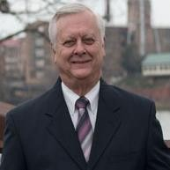
U.R.P. TEAM
Investment Advisor
Dave Jackson
Dave Jackson brings over 35 years of experience in Real Estate as an Investor in Georgia, Alabama, and Florida. Dave specializes in income-producing assets which include multi-family, mobile home parks, self-storage facilities and convenience stores. Before joining G2 Commercial, Dave was a realtor with Keller Williams who was specializing in Military PCS transfers, Senior’s Real Estate, Short Sale and REO properties as well as some Commercial, Multi-family, Self-storage, Manufactured Home Communities and RV Parks.
Investment
Advisor
Jim Lester
Jim Lester brings over 35 years real estate experience, and a licensed realtor. Jim specializes in single family, and multi-family real estate. Jim is also a prior mortgage broker with the Armed Forces Insurance Corp. Owner of multiple businesses paralleled with real estate, such as construction, remodeling, redevelopment, and a investment firm. Retired US Army Military Officer. Masters in Business Administration from Auburn University. General Contractor Over 45 years, now many other states.

Slide 19
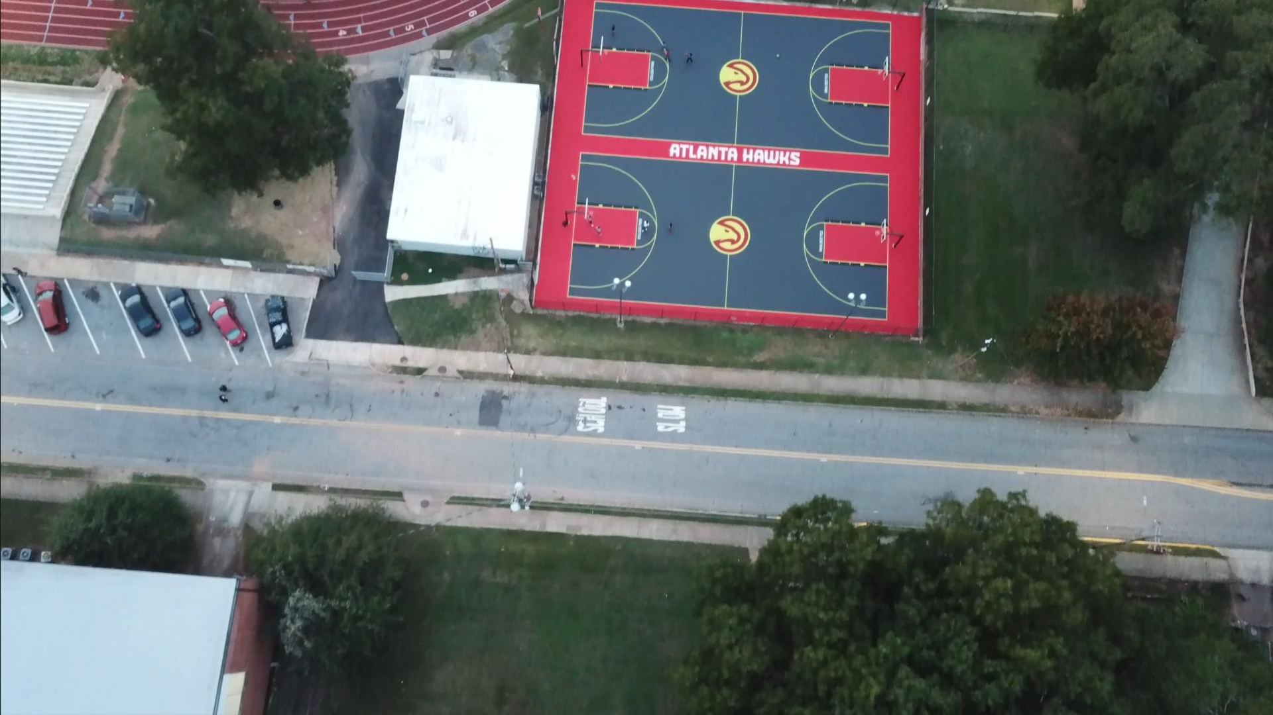
COLLEGE PARK OVERVIEW
CREDITS: VIDEO IS FROM COLLEGE PARK GOVERNMENT WEBSITE (HTTPS://WWW.COLLEGEPARKGA.COM)

Slide 20
METRO JOBS APROXIMATELY WITHIN 35 MINUTES OF RESIDENTS LIVING AREA
DIVERSITY
OPPORTUNITY
EDUCATION
Fastest Growing Metropolitan areas in the country.
B+ Based on ethnic and
economic diversity.
(According to the U.S.Census Bureau and
niche.com)
Population has grown 7.97% since 2010 and continues to grow due to the job opportunities in the Atlanta market.
90% High School Graduates or higher
24% Bachelor’s Degree or higher About the same as the rate in the Atlanta-Sandy Springs-Alpharetta, GA Metro Area: 89.6%
(According to

Slide 21
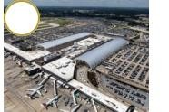
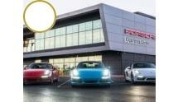
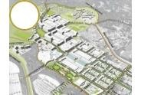
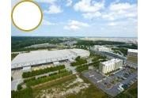
IN THE AREA
H A R T S F I E L D - J A C K S O N AT L A N TA I N T E R N AT I O N A L A I R P O R T
Hartsfield-Jackson has been the world's busiest airport since 1998, both in passengers and number of flights, by accommodating 95 million passengers and 950,119 flights. In addition to hosting Delta's corporate headquarters, Hartsfield-Jackson is also the home of Delta's Technical Operations Center. The airport has international service to every major continent.
P O R S C H E E X P E RI E N C E C E N TE R
The Porsche Experience Center in Atlanta is a bold and dynamic experience that reflects the authenticity of Porsche products and services as well as the company's character. The 26.4-acre site includes Porsche heritage displays, a test track, historic vehicle restoration conference and meeting space, a restaurant, café, and Human Performance Center.
A I R P O R T C I T Y D E V E L O P M E N T
The new plan by Sizemore Group of Atlanta calls for nearly 5 million SF of class-A office, including corporate headquarters; as many as six hotels; and 758,000 SF of retail, including multiple restaurants and a premium outlet mall. The 420-acre site is just west of the airport.
G E O R G I A I N T E R N AT I O N A L C O N C E N T I O N C E N T E R
The Georgia International Convention Center, or GICC, opened in April 2009, is the second-largest convention center in Georgia, after the Georgia World Congress Center. It is the world's only convention center directly connected to a major airport.

Slide 22
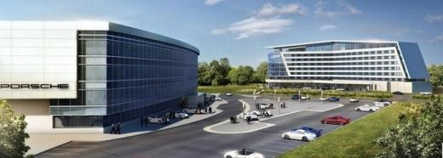
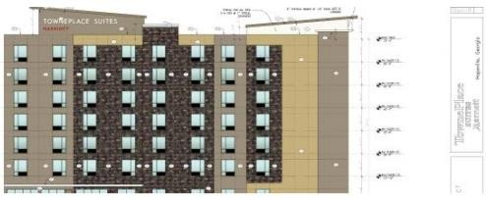
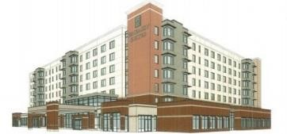
AREA DEVELOPMENTS
PORSCHE AT AE ROTROPLIS
In 2006, Ford Motor Company announced the closure of its assembly plant in Hapeville, Georgia, directly adjacent to Hartsfield-Jackson Atlanta International Airport. Jacoby Development acquired the site, demolished its structures, and put together an ambitious redevelopment plan for it. In 2011, Porsche Cars North America announced the plan to develop a new North American headquarters facility at the site, which includes a 220,000 SF headquarters office building, the Porsche Technical Training Center, and the Porsche Customer and Driving Experience Center, featuring a 1.6-mile test track and handling circuit.
Porsche opened its $100-million facility in 2015 to great acclaim, and an adjacent hotel opened in late 2017. These investments have been catalysts for additional investment and commercial development around the airport.
TOWN PLACE SUITES
A new plan has been approved to begin construction of a 112-room, 7-story, 9,350 SF Towne Place Hotel located at 3424 Norman Berry Drive. The hotel will offer a shuttle between the airport and has agreed to a partnership with Delta Airlines.
EMBASSY SUIT ES H OTEL
Embassy Suites has been approved to construct a 174-room, 156,900 SF hotel. The new hotel will have modern finishes with 2 pools and a restaurant. Construction will take place at 3399 International Boulevard.
* Source: https://www.hapeville.org/468/Major-Development- Annoucements
New Porsche HQ, hotel and Driving Experience Center
New 112-room development by Town Place Suites
New 174-room development by Embassy Suites

Slide 23
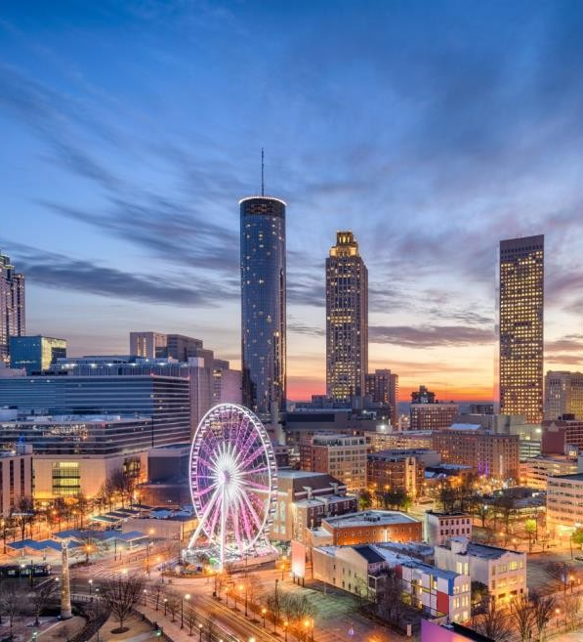
COLLEGE PARK ECONOMY
500k+ population in Atlanta GA.
15 minutes from the city of Atlanta, GA. (According to the U.S. Census Bureau)
3.7%
Low Employment rate, .4% lower than GA at 4.7%.
4,000
Businesses In Operations
College Park is home to Hartsfield-Jackson Atlanta International Airport which employs approximately 63,000 plus people, making College Park one of the largest employment districts in Georgia. Service-related employment (airport related and hospitality) are the dominant growth sectors in College Park with over 4,000 service sector jobs created since 1991.

Slide 25
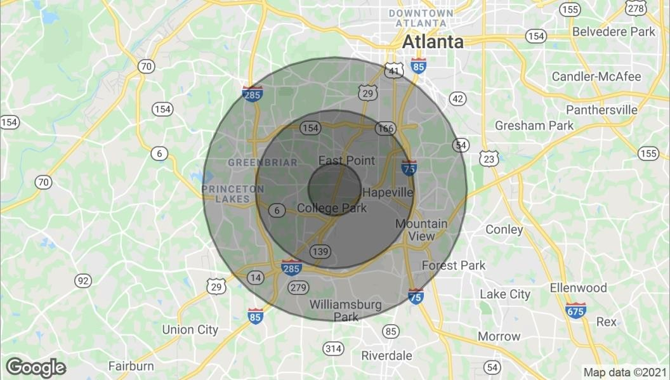
DEMOGRAPHIC OVERVIEW
D EM O G R A P H I C S
POPULATION | 1 Mile 3 Miles | 9,771 66,304
 | 5 Miles | 168,643
HOUSEHOLDS | 1 Mile 3 Miles 5 Miles | 4,100 26,743 66,674
AVG. HH INCOME | 1 Mile 3 Miles $54,030 5 Miles $55,245 | $70,508

Slide 26
NEIGHBOURHOOD
SCHOOLS
Woodward Academy Primary School
Woodward Academy Private School, Middle, and Lower School
TRANSPORTATION
Marta Station and Marta Bus Routes Nearby
Attractions to the city are about 15 minutes commute without traffic, and 35 minutes with traffic.
Restaurants, grocery stores, and convenient stores less than 5 minutes
away.

Slide 27
INVESTOR RETURNS
PARTNERSHIP RETURNS | ROI/Yr | EMx | IRR
URP Properties LLC | 18.3% | 1.28X
Investors LP | 22.3% | 1.56X | 8.00%
PROPERTY RETURNS |  | EMx | IRR
Unlevered |  | 2.21X | 13.13%
Levered |  | 3.24X | 20.95%
DEVELOPMENT RETURNS |  | Untrended
Yield-on-Cost |  | 8.90%
Market Cap Rate |  | 4.90%
Development Spread |  | 400.1 bps
 | In-Place | Stabilized | Sale
Net Operating Income | (10,268) | 233,046 | 261,235
Cap Rate | 4.90% | 5.48% | 6.25%
Valuation | (209,549) | 208,522 | 4,179,758
% of Total Project Cost | -8.3% | 8.3% | 165.5%
Valuation/Unit | -7,484 | 7,447 | 149,277

Slide 28
REAL ESTATE GLOSSARY
Capitalization Rate (Cap Rate)
A rate of return on a real estate investment property based on the expected income that the property will generate. Capitalization rate is used to estimate the investor's potential return on his or her investment. This is done by dividing the income the property will generate (after ﬁxed costs and variable costs) by the total value of the property.
When acquiring income property, the higher the capitalization rate (“Cap Rate”), the better. When selling income property, the lower the Cap Rate the better.
A higher cap rate implies a lower price, a lower cap rate implies a higher price.
Cash Flow
Cash generated from the operations of a company, generally deﬁned as revenues less all operating expenses.
Cash-on-Cash
A rate of return often used in real estate transactions. The calculation determines the cash income on the cash invested.
Calculated as Annual Dollar Income Return / Total Equity Invested = Cash-on-Cash
Internal Rate of Return (IRR)
The rate of return that would make the present value of future cash ﬂows plus the ﬁnal market value of an investment opportunity equal the current market price of the investment or opportunity. The higher a project's internal rate of return, the more desirable it is to undertake the project.
Return on Equity (ROE)
The amount of net income returned as a percentage of shareholders equity.
ROE is expressed as a percentage and calculated as Return on Equity = Net Income / Shareholders Equity Levered IRR
Initial return with the use of debt.
Unlevered IRR
Initial return without the use of debt.

Slide 29
CONTACT US FOR ANY QUESTIONS.
JOHN COPPOCK
PARTNER, U.R.P. PROPERTIES,
johncoppock@urpproperties.com
404-984-3130
JOHN SWINDLE
PARTNER, U.R.P. PROPERTIES
johnswindle@urpproperties.com
614-817-9524
Information contained herein may have been provided by the seller, landlord or other outside sources. While deemed reliable, it may be estimated, projected, limited in scope and is subject to change or inaccuracies. Pertinent information should be independently confirmed prior to lease or purchase offer or within an applicable due diligence period.

